Slide 1

What is on a [New Zealand] demographer’s mind?
Natalie Jackson
Global demographers –
Population Ageing
Empirical research
Population Policy ±
Professor of Demography, Director, National Institute of Demographic and Economic Analysis (NIDEA)
Presentation to Demography/Actuarial Science Workshop , Victoria University of Wellington, 26th June 2013

Slide 2
What is on a demographer’s mind? A worldwide survey
Hendrik P. van Dalen, Kene Henkens 2012, Demographic Research, 26, 16, 363-408
  970 demographers around the globe
Population ageing 30%*
Large scale migration flows 14%*
HIV/AIDS 13%
Above-replacement fertility 12%
Urbanisation 12%*
Infant mortality 10%
Women’s reproductive rights 7%
Population decline 2%*

Slide 3
What is on a [New Zealand] demographer’s mind?
Population ageing
  Migration flows
  Urbanisation
  Regional Decline
Empirical research
  How to measure /project ethnicity / COB
  How to measure /project fertility
  How to project migration
Population Policy (PANZ, tomorrow)

Slide 4
Population ageing.. Is it so straightforward?

Slide 5
What Population Ageing [really] means. A phenomenon in four dimensions
Some critical distinctions
Numerical Ageing
  Increase in numbers of elderly (primarily caused by increased life expectancy - and in-migration of retirees)
Structural ageing
  Increase in proportions of elderly (primarily caused by low/falling birth rates – and out-migration of young adults)
Natural decline
  More elderly than children ➢ ➢ more deaths than births
Absolute decline
  Inability of ‘replacement migration’ to replace the ‘lost’ births and increased deaths (migration gain/loss acclerates the ‘problem’)

Slide 6
Population ageing – the big picture
.. What does it mean for ‘population stability’; ‘stationarity’?

Slide 7
Key concepts
Stable population
  Closed to migration, unchanging age-sex structure, size increases/decreases at a constant rate (births > deaths; vice-versa)
  Implausible, needs revision to incorporate migration
Stationary population
  Closed to migration, unchanging age-sex structure, ZPG..
  Assumes long run replacement level fertility (2.1 births per woman)
  Assumes crude birth rate = crude death rate
  Implausible, no reason why TFR should magically settle at 2.1
Reality..
  Most populations reaching the end of growth have gone straight through to depopulation
  Depopulation begins sub-nationally
  Increasingly driven by interaction between hyper-ageing (>20% 65+ years) and migration flows

Slide 8
A new set of dynamics
Old form of population decline
  Net migration loss, typically 20-39 years > natural increase
New form of decline
  Net migration loss 20-39 yrs
  +
  Fertility Decline
  +
  Net migration gain at older ages
  +
  Natural Decline
How to measure contributing factors?
65+ yrs: 21.2% … 25.4%

Slide 9
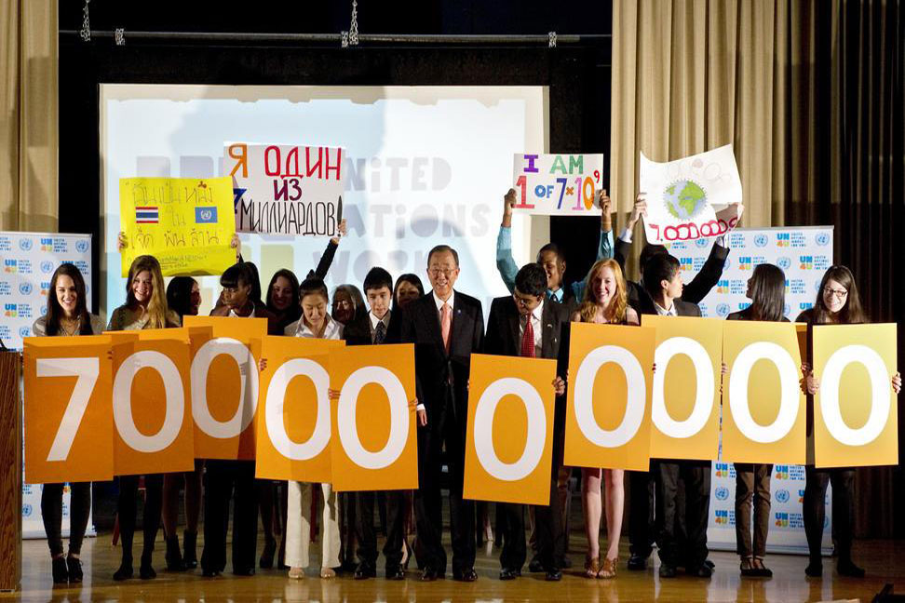
So.. 7 Billion and Counting. Yes, but..

Slide 10

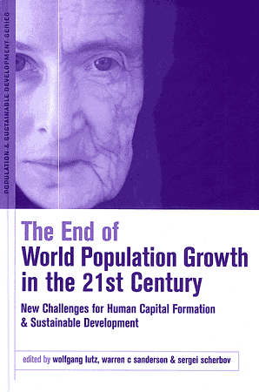
The end of growth is on the horizon

Slide 11
Ageing-driven growth is not the same as youth-driven growth
Source: Statistics NZ 2012 Projected population of New Zealand by age and sex, 2011(base)-2061

Slide 12
Ageing-driven growth is finite
MDCs (58) Medium Series | 65+ Years | All other age groups combined
2011-2021 (2.9%) | 25% | -1.3%
2011-2031 (4.6%) | 49% (+98 million) | -3.9% (-41million)
US Census Bureau International Database: More Developed Countries by age and sex
Notes:
12

Slide 13
Ageing-driven growth – most of New Zealand
2/3 of New Zealand’s growth 2011-2031 expected to be at 65+ years
Total NZ Medium Case | 65+ Years | All other age groups combined
2011-2021 (8.9%) | 40.3% | 4.1%
2011-2031 (17.9%) | 88.5% | 7.1%
Source: Statistics NZ 2012 Projected population of New Zealand by age and sex, 2011(base)-2061
Notes:
13

Slide 14
New Zealand will have more elderly than children within 13 years
Already crossed over in 10 (15%) TAs
Projected

Slide 15
Ageing - and the speed of ageing - differs across the country
*4 RCs Already have fewer labour market ‘entrants’ than ‘exits’

Slide 16
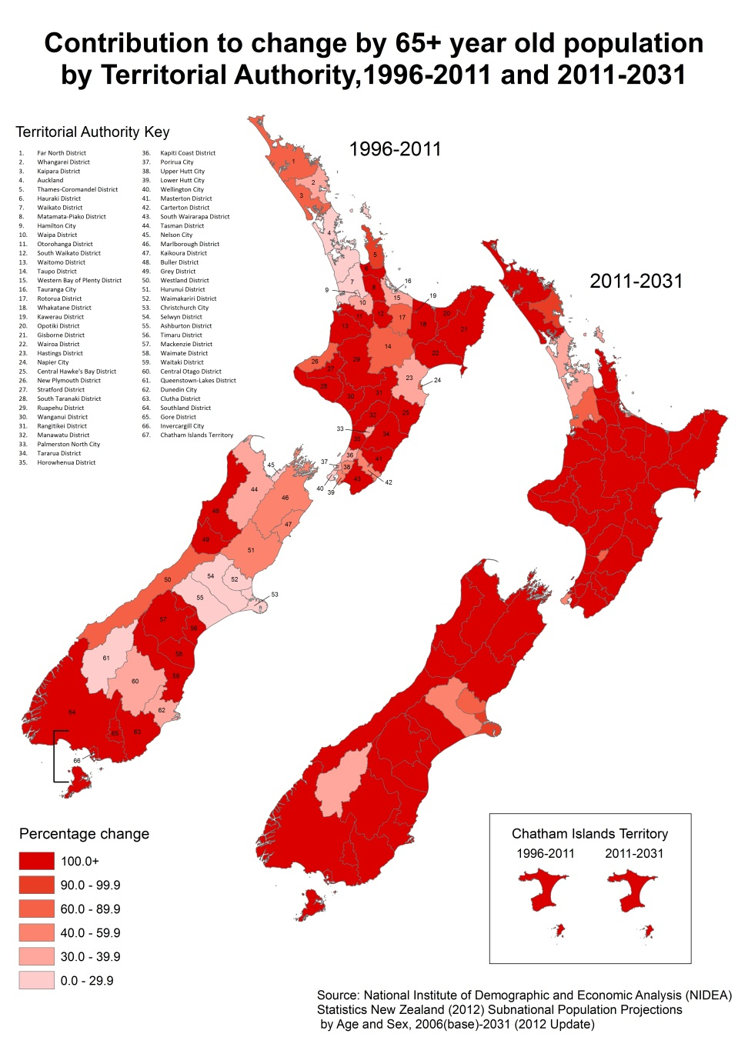
Next 20 years:
Nationally 66% of growth will be at 65+ years (23% past 15 years)
84% (56) TA’s will have more than 100 per cent of ‘growth’ at 65+ years; all are projected to experience overall decline at 0-64 years
  1996-2011 32 TAs (48%)

Slide 17
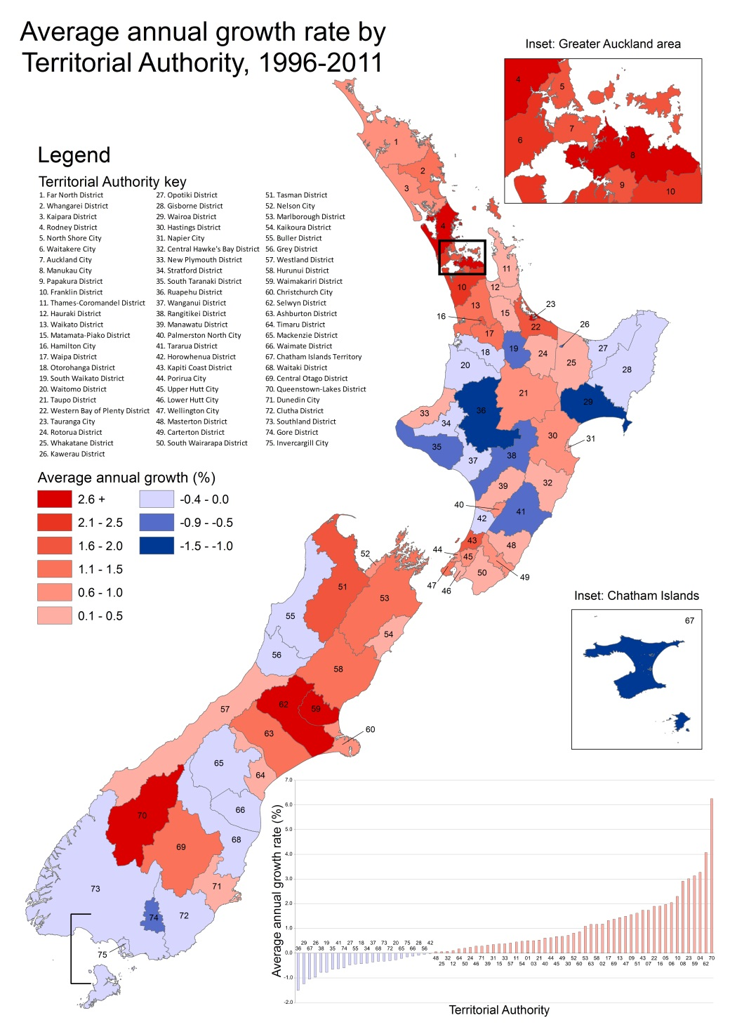
Does it matter?
It matters a lot..
36% of New Zealand’s TA’s already in absolute decline
How can we assist in modelling this?
When will the sum of regional trends tip the national trend towards unavoidable ZPG?
Key indiator/thresholds approach

Slide 18
Key Ageing Indicators (New Zealand)
67 TA’s | 1996 | 2011 | 2031
 | Number / Percentage
65+ years (%) | 11.5% | 13.3% | 21.3%
More elderly than children | 0 | 11 (16%) | 52 (91%)
Fewer LM entrants than exits | 5 (7%) | 26 (36%) | 47 (70%)*
Reproductive Age Pop (25-44yrs) <20% of total population | 0 | 7 (10%) | 11 (16%)
Natural Decline | 0 | 1 (1.5%) | 16 (25%)
???
Statistics New Zealand, Estimated Usual Resident Population; National Population Projections 2012 Update Medium Variant (50th percentile)
Notes:
18

Slide 19
Percentage TAs with fewer labour market entrants than exits
Observed Projected
Source: Statistics New Zealand, Subnational Population Projections: 2006(base)–2031 (October 2012 update)

Slide 20
More elderly than children (% NZ Territorial Authority Areas)
Observed / ERP
Projected
Source: Statistics New Zealand, Subnational Population Projections: 2006(base)–2031 (October 2012 update)

Slide 21
Measuring Ethnicity
.. What does it mean for key indicators – the TFR? Projections? Can we do this better yet?

Slide 22
New Zealand pays much attention to the issue
Four census questions
  Ethnic Group - affiliation
  Language – conversant in Māori
  Descent – ‘blood’
  Iwi – identification
    also Country of Birth

Slide 23
Population by age, sex and ethnicity* (c.2011) -1
Highly disparate age structures
*Stats New Zealand Multiple Count

Slide 24
Population by age, sex and ethnicity (c.2011) -2
*Stats New Zealand Multiple Count

Slide 25
Ethnic ‘Over-count’ – which approach is best?
Of the 565,329 people identifying with Māori ethnicity at the 2006 Census, 47 per cent (266,934) also identified with non-Māori ethnicities
 | 1996 | 2001 | 2006
Total without multiple count | 3,732,000 | 3,880,500 | 4,184,500
Summed TOTAL NZ pop | 4,090,270 | 4,221,900 | 4,582,150
Total Ethnic 'overcount' (%) | 9.6 | 8.8 | 9.5

Slide 26
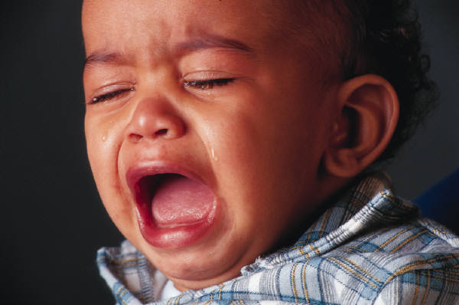
The Total Fertility Rate
Do we need an ethnic-weighted rate?
A Country-Of-Birth weighted rate?

Slide 27
ASFR, TFR and Reproductive Age Groups by Ethnicity* c.2011
How does use of un-weighted ASFR affect our projections?
 | ASFRs
15-19 | 25.82
20-24 | 72.73
25-29 | 104.37
30-34 | 121.57
35-39 | 71.27
40-44 | 14.77
45-49 | 0.79
TFR | 2.054
*Stats NZ Multiple Count Ethnicity

Slide 28
Ethnic* share of reproductive age group 2011, 2026
2011 2016
*Stats NZ Multiple Count Ethnicity

Slide 29
There are plenty of issues to keep a NZ demographer’s mind busy..
Life Expectancy
  How ‘rectangularised’ can we get?
  How far can life expectancy realistically extend?
Migration
  Should the projection assumption be a constant number, or a rate?
  Constant number may prove correct if competition for migrants increases
???
90% to age 65

Slide 30
Thankyou
natalie.jackson@waikato.ac.nz
www.waikato.ac.nz/nidea

